Slide 1
Algorithms in Smart Speakers
Signal and Audio Processing

Slide 2
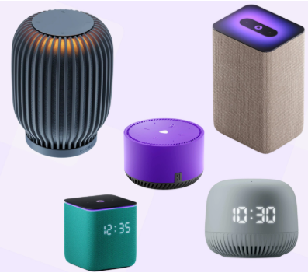
Algorithms in Smart Speakers
Adaptive Echo Cancellation (AEC)
Audio Prefiltering
Speaker Direction of Arrival and Beamforming
Voice Activity Detection
Wake phrase detection (Keyword Spotting)
Automatic Speech Recognition (ASR)
Natural Language Understanding and Responding
Text-To-Speech (TTS)

Slide 3
Adaptive Echo Cancellation
Setting: smart speaker outputs own sound (plays music, speaks, etc.)
Problem: this sound reflects from room walls and return to speaker’s microphones
Goal: subtract from microphone audio signal the own output sound

Slide 4



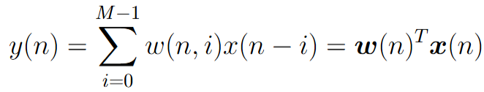


LMS (Least Mean Square)
- speaker’s own sound
- room impulse response at current time moment n
- audio recorded by microphone
- predicted audio for microphone (assuming user is not speaking)
- prediction error
Gradient descent update step:
Problem: update is proportional to x(n), may lead to instabilities when x(n) is drastically changing

Slide 5
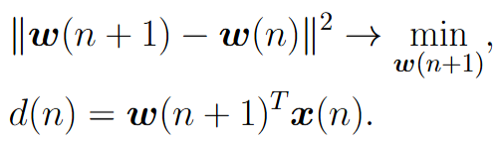
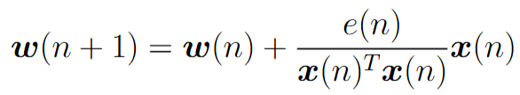

NLMS (Normalized LMS)
Idea: find minimal change to previous w(n), that can explain the current d(n)
Using Lagrange function the optimal solution is:
Practical formula:
In NLMS w(n) are updated on every time moment with large M. For acceleration Frequency Domain Adaptive Filter (FDAF) is used when updates are made by blocks in spectrum domain

Slide 6
Audio Prefiltering
Goal: filter human input voice from all other noise sounds in the room (hum of refrigerators, keyboard clicking, dog barking, etc.)

Slide 7
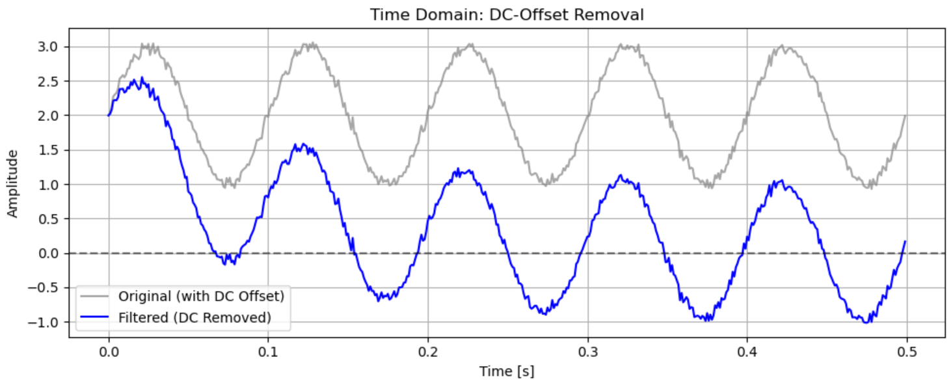
Direct Current Offset Removal
Problem: microphone electronics can add constant shift to registered audio. This influences all other elements of audio processing
Solution: apply small IIR filter, that filters out low frequences below 5Hz

Slide 8
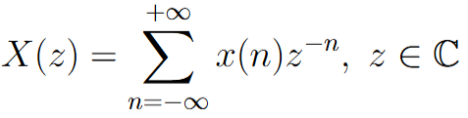
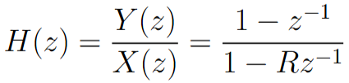
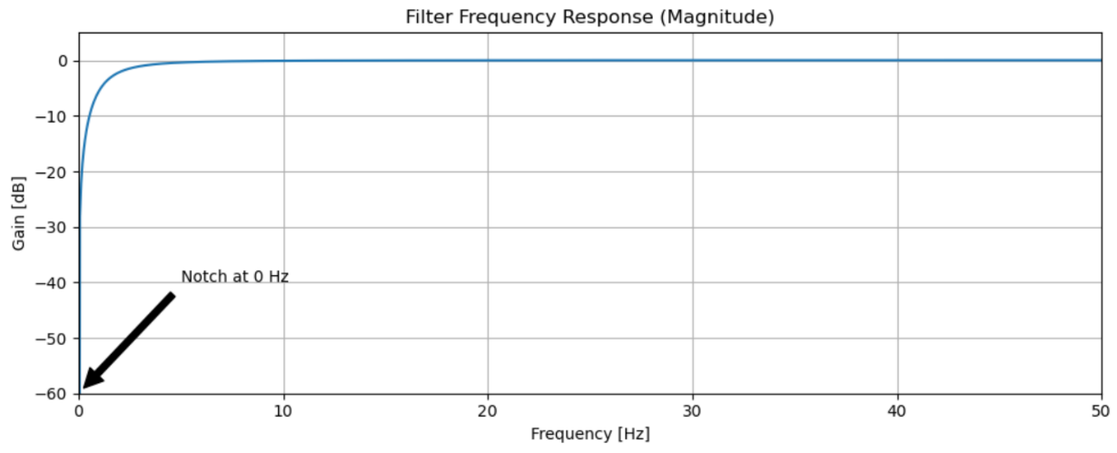
Direct Current Offset Removal
IIR filter:
Z-transform:
Transfer function:
Zero z=0 – constant shift is fully cancelled
Pole z=R – filter is stable
Magnitude response:

Slide 9
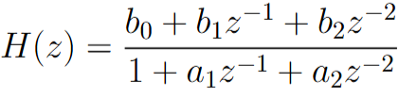
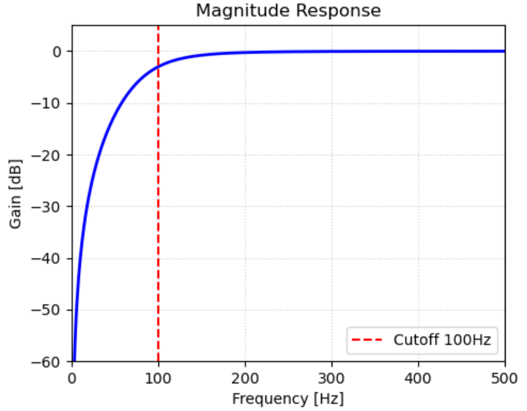
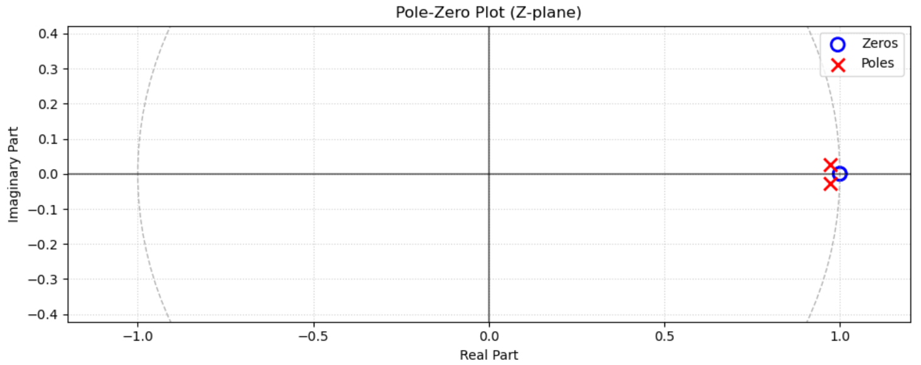
100 Hz High Pass Filter
Human voice has frequencies starting from 80-100 Hz. All lower frequencies are reasonable to filter out
Butterworth 2-nd order IIR filter:

Slide 10
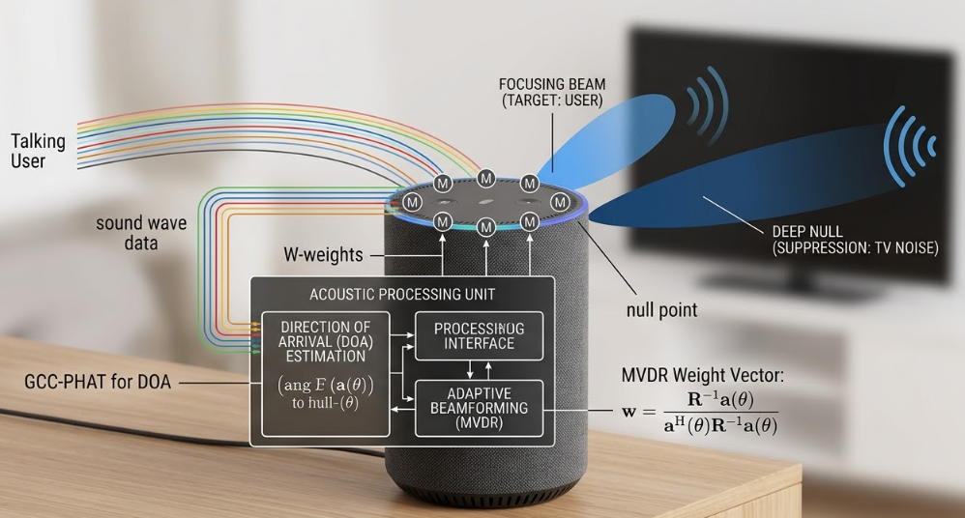
Microphone Array
Smart speaker has many microphones (usually located in a circle)
DC Removal, AEC, HPF are applied for each microphone separately
Next steps: determine angle of each voice source in room (Direction of Arrival) and amplify sound for direction from user / mute sound for direction from TV (Beamforming)

Slide 11
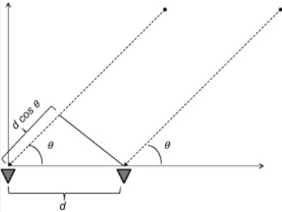




Direction of Arrival (DOA)
Consider microphone array located in a line
- distance between two microphones
- delay in time (phase) for input signal on two microphones, c – sound speed
Find delay by maximizing cross-correlation:
Estimated angle:

Slide 12
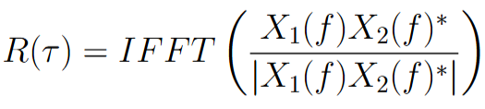
GCC-PHAT for DOA (Generalized Cross-Correlation with PHAse Transform)
In rooms with strong echo, voice wall reflection can lead to false peaks in cross-correlation
Idea: suppress information about amplitudes and consider only phases

Slide 13
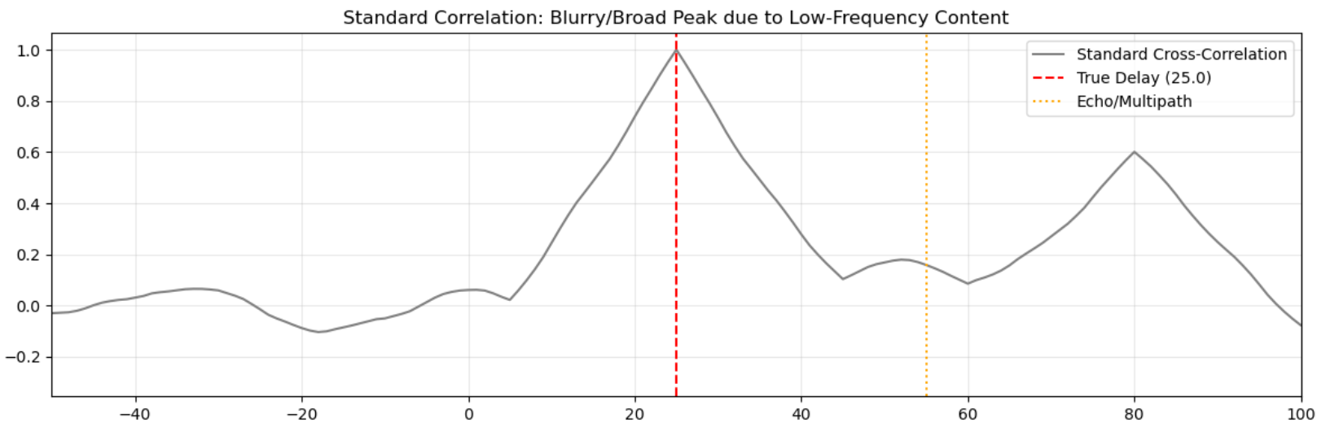
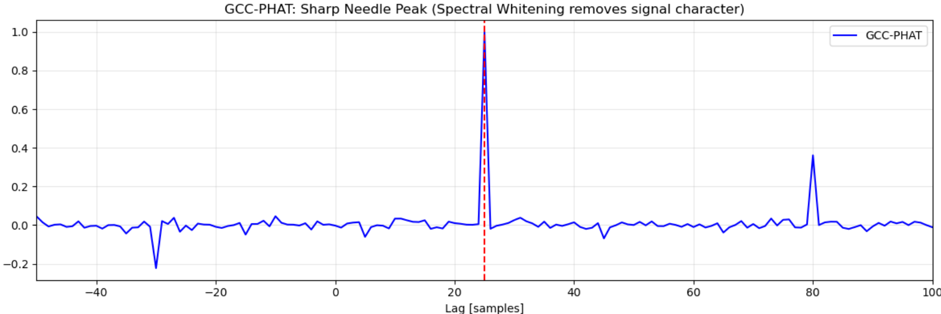
GCC-PHAT vs. Cross-Correlation

Slide 14
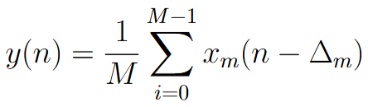
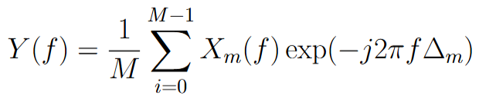
Delay-and-Sum Beamforming
Idea: artificially delay signals from microphones and sum
In frequency domain:
MVDR (Minimum Variance Distortionless Response) – more advanced Beamformer, that can amplify user signal and mute noise sources

Slide 15
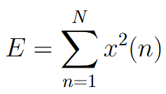
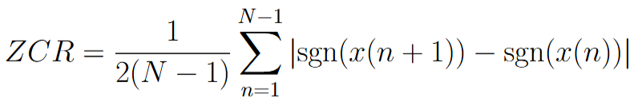
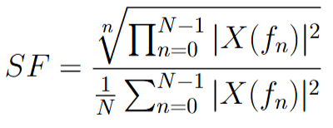
Voice Activity Detection (VAD)
Goal: determine for given audio fragment: human voice vs something else
Energy for audio frame:
Zero Crossing Rate:
Spectral Flatness:
VAD: If Energy is high, ZCR is low and SF is low then human voice

Slide 16
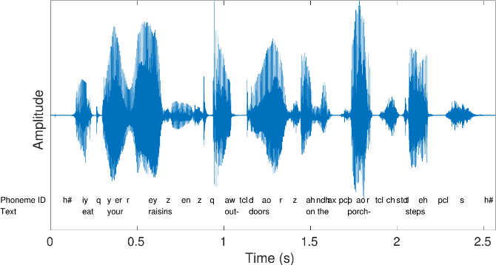
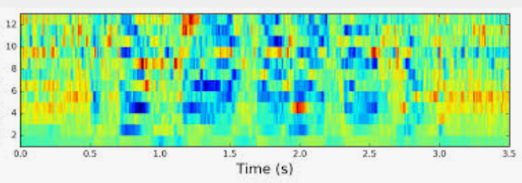
Neural Network based VAD
NN
Class label (human / non-human)
Audio waveform
MFCC Spectrogram
(or Log-Mel-Spectrogram)

Slide 17
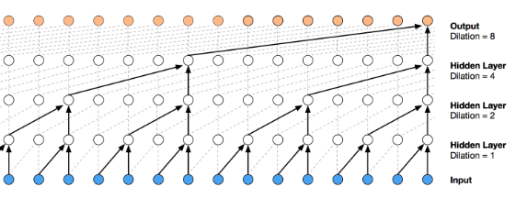
Neural Network based VAD
NN architecture: Time Convolutional Neural Network + (possibly) Recurrent Layers
Training: classes 1) Human Voice, 2) Voice + Noise, 3) Voice + Music, 4) Music, 5) House devices, 6) outdoor noise, etc.
Testing: joint probability for all classes with Human Voice
Model example: Silero VAD

Slide 18
Key Word Spotting
NN
Class label („Alexa“/ something else)
Audio waveform
MFCC Spectrogram
(or Log-Mel-Spectrogram)
NN architecture: Temporal CNN + Recurrent
Learns to separate “Alexa” vs. “Election”, “A Lexus”, “Unleash her”, etc.

Slide 19
VAD + Key Word Spotting
VAD is cheap and small network, applied for every frame
If VAD detects human voice, then local KWS network is asked
If local KWS detects keyword, then cloud connection is opened and heavy KWS network is asked. This network accounts also for TV advertisement
If global KWS detects keyword, then ASR (Automatic Speech Recognition) is started

Slide 20
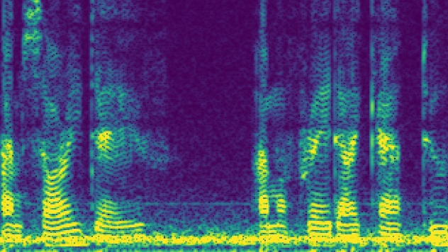
ASR pipeline
Hello, …
NN
Audio waveform
Log-Mel-Spectrogram
Output text

Slide 21
ASR architectures
LAS: encoder-decoder model with attention
DeepSpeech: encoder-only model with CTC loss
RNN-Transducer: encoder-decoder model with monotonic alignment, suitable for streaming ASR

Slide 22
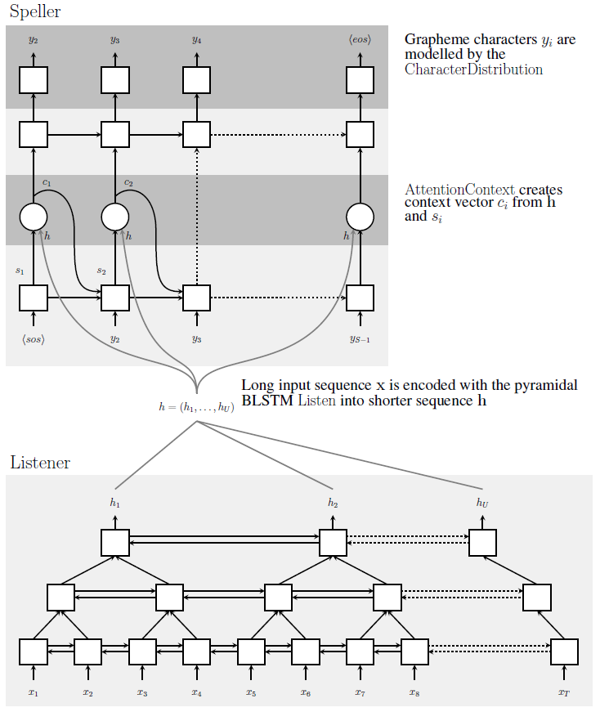
Listen, Attend and Spell (LAS, 2015)
Architecture: Encoder-Decoder model with attention
Encoder: pyramid bidirectional LSTM
Decoder: autoregressive LSTM
Inference: Beam search
Pros: good quality, ability to use separately pretrained encoder for audio (Conformer-like) and decoder for text (GPT-like)
Cons: very slow on inference, requires full input audio to make recognition

Slide 23
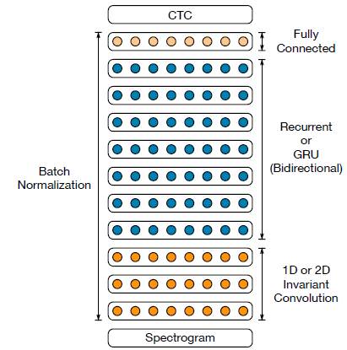
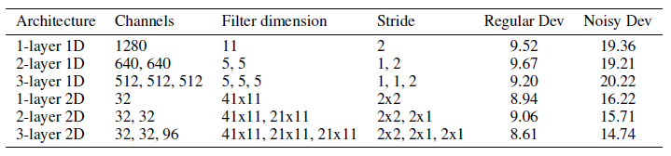
Deep Speech 2 (2016)
Architecture: Encoder only model + CTC loss
Encoder uses 1) convolutional layers (1d or 2d), 2) RNN layers and 3) FC layers
Inference: beam search + separate language model (non-autoregressive word n-gram model like KenLM)
Pros: fast inference
Cons: requires separate language model, can’t use pretrained text decoder

Slide 24
Using language models on inference
Example: I’ll write it right now
Words “write”, “right”, “rite” have almost identical pronunciation
DeepSpeech: each output token is generated independently from each other => without separate language model can output “I’ll right it right now”
LAS: decoder is autoregressive, next token is generated conditioned on previously generated token => can show good performance without additional language model

Slide 25
RNN Transducer (RNN-T, 2012)
Transducer – the best from two worlds (LAS and DeepSpeech): fast inference, can use pretrained models, suitable for streaming ASR
In ASR alignment between input audio and output text is monotonic
Audio Encoder: biLSTM or Conformer, for audio $x_{1},…, x_{T}$ outputs hidden vectors $h_{1},…,h_{T}$
Text decoder (prediction network): autoregressive LSTM or GPT, for text $y_{1},…, y_{U}$ outputs hidden vectors $g_{1},…, g_{U}$
Joiner network: small MLP, for each pair $\left(h_{t}, g_{u}\right)$ outputs probabilities $p(y|h_{t}, g_{u})$ for all text tokens and additional blank symbol $∅$

Slide 26
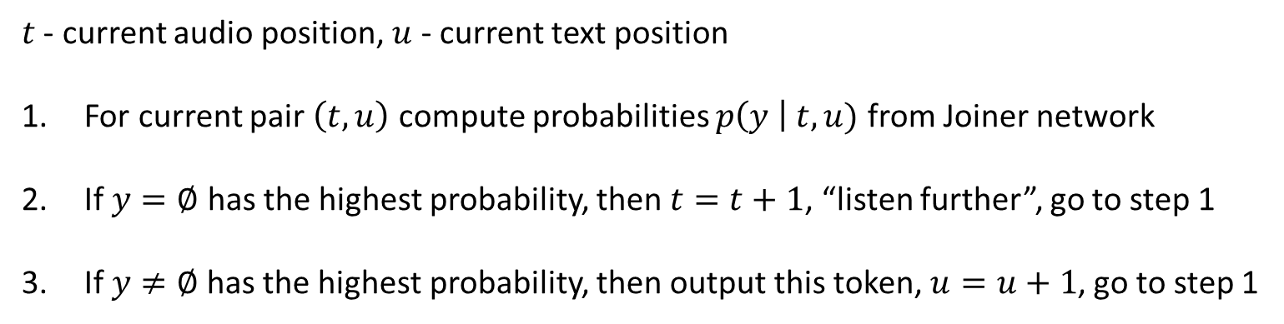
RNN-T Inference
$t$ - current audio position, $u$ - current text position
For current pair $\left(t, u\right)$ compute probabilities $p\left(y \right| t, u)$ from Joiner network
If $y=∅$ has the highest probability, then $t=t+1$, “listen further”, go to step 1
If $y≠∅$has the highest probability, then output this token, $u=u+1$, go to step 1

Slide 27
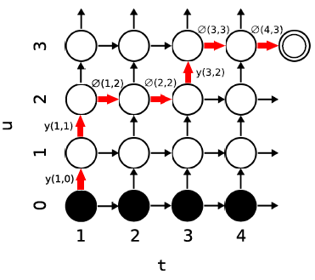
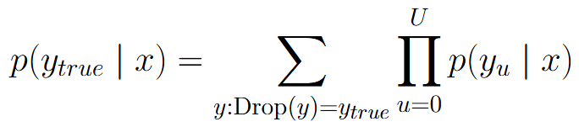
RNN-T Training
Consider Drop operation: drop all empty symbols
Loss function for RNN-T is determined by probability:
Efficient computation of this probability using Dynamic Programming:

Slide 28
RNN-T properties
For ASR streaming let’s process audio in chunks 300-500 ms
Prediction network is autoregressive => doesn’t need a separate language model on inference
Can use pretrained models for both audio encoder and text decoder

Slide 29
Text Normalization
Text normalization: transformation of written text to pronounced text
Example of input text: Hi, Dr. Smith! We've seen the report from NASA... it's about $19.99, or 20% off the usual price. I saw it on the news at 3:00 PM. The FBI might investigate, y'know? [laughter]
Example of normalized text: hi doctor smith we have seen the report from nasa it is about nineteen dollars and ninety nine cents or twenty percent off the usual price i saw it on the news at three p m the f b i might investigate you know
Elements of normalization: only lower case letters, no punctuation, numbers are pronounced, abbreviations are pronounced, special signs like $, % are pronounced, etc.
Inverse normalization operation is also needed

Slide 30
Text tokenization
Three options:
Separate letters: a, b, c, … + blank, unknown; leads to very long text sequences
Phonemes: hello → [h, ə, l, oʊ]; logical from linguistics point of view, requires non-trivial Grapheme-To-Phoneme (G2P) and inversed Phoneme-To-Grapheme models
The same letters may correspond to different pronunciation: tough, through, though
The same pronunciation may correspond to different words: write, right, rite, wright
Text tokens: BPE, WordPiece, etc.; modern mostly used approach, also needed in case of pretrained text models

Slide 31
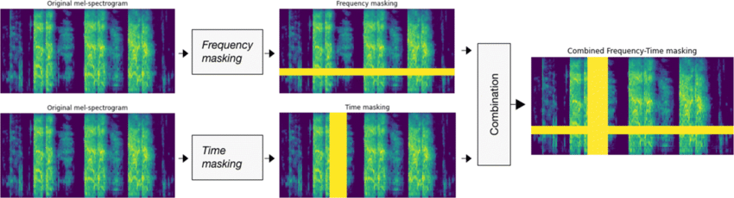
Audio augmentation
SpecAugment: Frequency and Time masking applied to spectrograms
Noise Injection: adding different noise to initial audio in time domain
Acoustic Simulation: adding filters of time domain audio in order to imitate big lecture hall, small bathroom, etc.
Time and Pitch distortion: accelerate and slow down audio signal, shifting pitch (F0)

